Slide 1
STUDE NT PORTFOLIO
STUDENT NAME :BRUNTHAVATHI.R
REGISTER NO :24131210500122011
DEPARTMENT :2nd BCA
COLLEGE :IMMACULATE COLLEGE FOR WOMEN
NAAN MUDHALVAN ID:asanm12124213011

Slide 2
PORTFOLIO

Slide 3
AGENDA
1.Project Statement
2.Project Overview
3.Tools and Technologies
4.Portfolio Design and Layout
5.Features and Functionality
6.Result and Screenshots
7.End Users
8.Conclusion
9.GitHub Link

Slide 4
PROBLEM STATEMENT
What specific issue are you facing with your digital portfolio?
What are you goas for the portfolio?
What challenges have you encountered so far?

Slide 5
PROJECT OVERVIEW
Project goalsand objectives.
Target audience.
Key features and functionalities.
Technical requirements or platforms being used.

Slide 6
TOOLS AND TECHNOLOGIES
Website builders.
Content management systems like Wordpress or joomla.
front-end frameworks.
Design tools.
Hosting platforms.

Slide 7
PORTFOLIO DESIGN AND LAYOUT
Clean and minimalistic design: Easy to navigate and focus on your work.
Clear typography: Legible fonts and font sizes.
Visual hierarchy: organize content to guide the viewer’s attention.
Imagery and visuals: High-quality images,videos,or graphics.

Slide 8
FEATURES AND FUNCTIONALITY
Project showcases: Displaying project with images,videos,or descriptions.
Easy navigation: Simple and intuitive menu or filtering system.
Contact informtion: Clear contact details or form.

Slide 9
RESULTS AND SCREENSHOTS
Add screenshots of portfolio project.
Demo screens.

Slide 10
END USERS
Potential employers.
Clients.
Industry peers.
Recruiters.

Slide 11
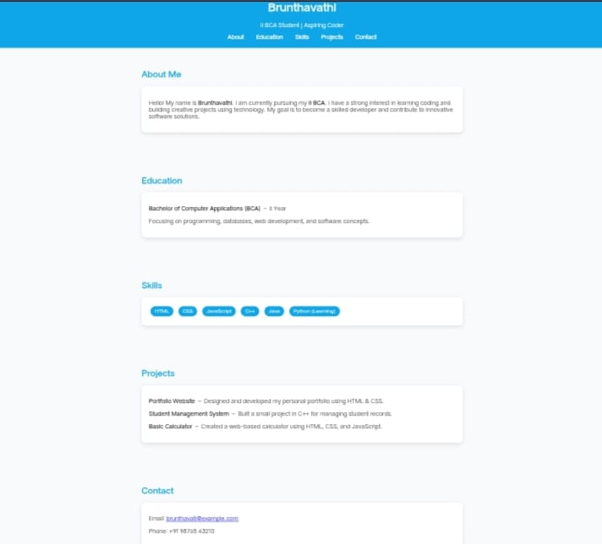
CONCULSION
Problem statements and project overviews.
End-users and their needs.
Tools and technologies for building portfolios.

Slide 12
GITHUB LINK
Direct Github repository link.
https://github.com/bbrunthavathi/Brunthavathi-.git

